Slide 1
Drillstring Hardbanding
Arcraft Plasma
India

Slide 2
Approved and certified systems
Systems are available offering hardbanding solutions for open and cased hole drilling.
Arcraft Hardbanding system applies wear resistant alloys using a gas shielded automatic consumable electrode process for cased hole drilling .
Hopper and feeder optional for automatic feeding of Tungsten Carbide granules in overlays required for open hole tubulars.
Advanced automation and control offers automatic , precise and high quality hardband application.

Slide 3
Introduction
Hardbanding of drill pipe tool joints and other drilling equipment has been around since the late 1930's. Originally, hardbanding was applied primarily to protect the drill pipe and other tools from premature abrasive wear. Conventional hardbanding material consists of granular tungsten carbide particles which are automatically fed into a molten puddle . Since that time, there have numerous changes in hardbanding and its application, but only within the last few years has new technology been introduced that allows hardbanding to protect the casing, the marine riser and the drill pipe at the same time.
Along with the new technology being utilized to drill the highly deviated wells such as horizontal ERD, or multi-directional, comes the problem of creating excessive downhole drag and torque. All of this drag and torque creates friction, which, in turn, creates wear on the drill string, the marine riser and the casing. Today, there are several types of wear resistant alloy hard-bandings on the market. Most of them are designed to protect either the casing, riser or the drill string, but only few of them can sufficiently protect all of them at the same time. Though the wear resistant alloy hardbanding technology has only been on the market for 6-8 years, it has gained increased popularity over conventional tungsten carbide hardbanding for several reasons.

Slide 4
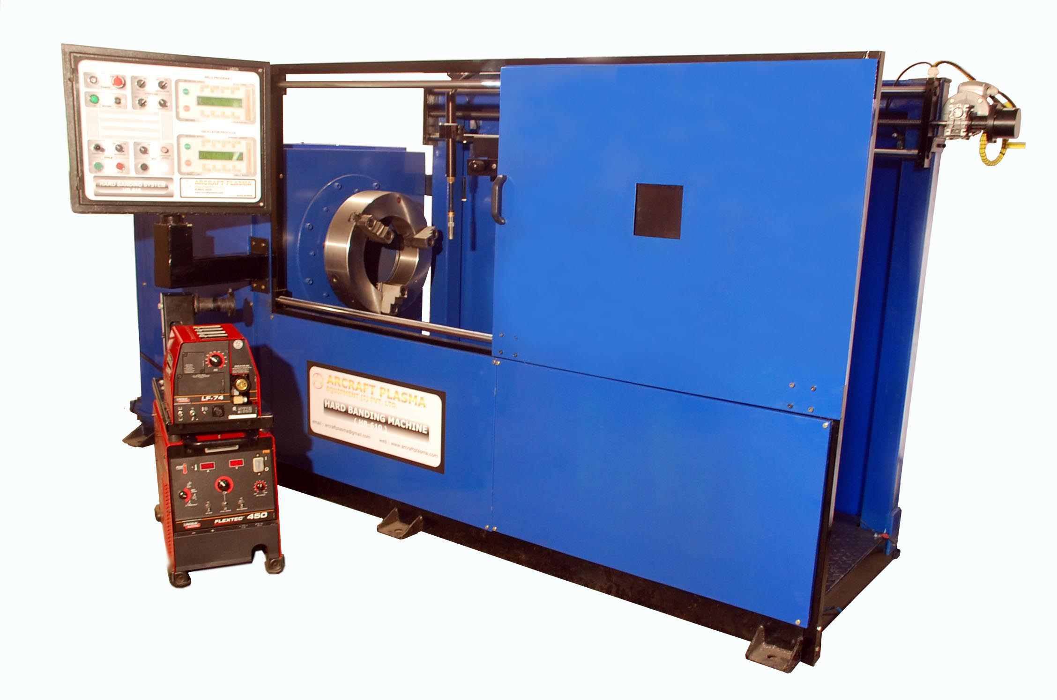
Hardbanding system

Slide 5
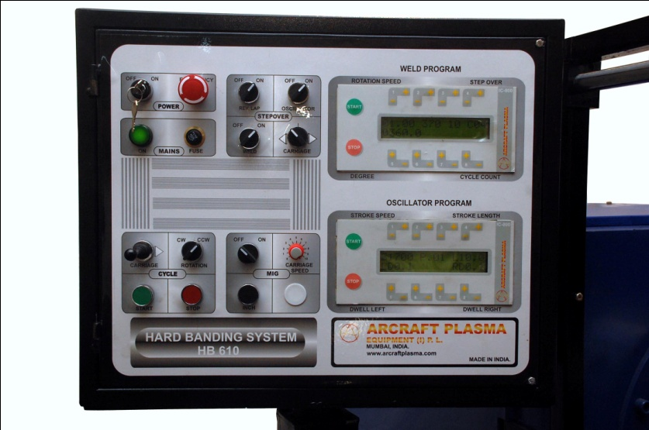
Control
Simplified Control Panel
Automatic Step over system
Program stop on number of bands
Oscillation system (slide type 1-25 mm) with variable speed.

Slide 6
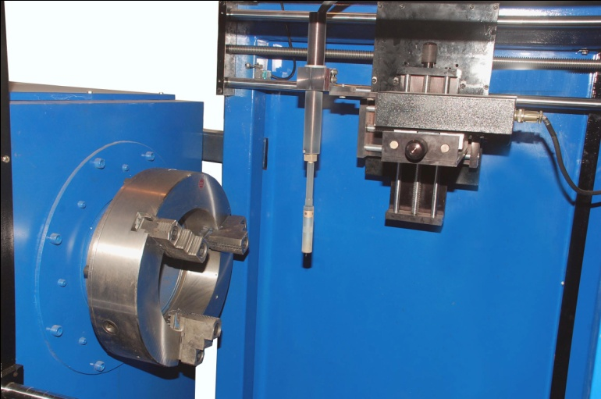
Ideal specs for chuck , spindle and power source
Hollow Barrel Chuck with Hardened Jaws.
10” (254 mm) ID Hole in chuck and spindle
Chuck and spindle size options available 8.66”, 10” & 12.6”
Spindle speed is 0.2 to 2 RPM
Heavy Duty GMAW torch
Unit is equipped to weld 1/16” (1.6mm) thru 3/32” (2.4mm) wires
450 Amp power supply (Lincoln Electric) or as per customer requirement.

Slide 7
Select options for new components or reapplication of Hardbanding
Submerged arc setup
Hopper and feeder for granules in case Tungsten Carbide overlays required in open hole tubulars
Optional tilting unit
Air Plasma Gouging
Induction heating systems
Can be fitted in container for mobile application on site work

Slide 8
Benefits
Substantially increase the tool joint wear life
Greatly reduce casing wear caused by the drill string
Substantially reduce downhole drag and torque
Reduce rig fuel consumption
Allow operators to run lighter weight and grade casing.

Slide 9
Locations for Hardbanding
Drillpipe Tool Joints
Heavyweight Drillpipe
Drill Collars

Slide 10
Thank you ! Do contact for more details
M/s. Arcraft Plasma Equipments (I) Pvt. Ltd.
124, Diamond Industrial Estate, Ketkipada, Near Check Naka,
Dahisar (East), Mumbai- 400068. INDIA.
Ph : 00-91-22-28965890, 28965745, 28963247
Fax : 00-91-22-28966418
Email : arcraftplasma@gmail.com
Web : www.arcraftplasma.com

